Slide 1
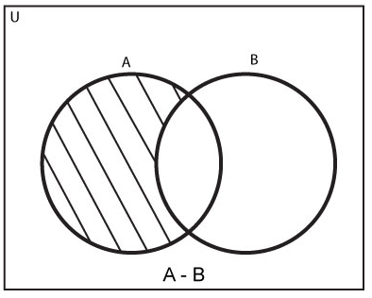
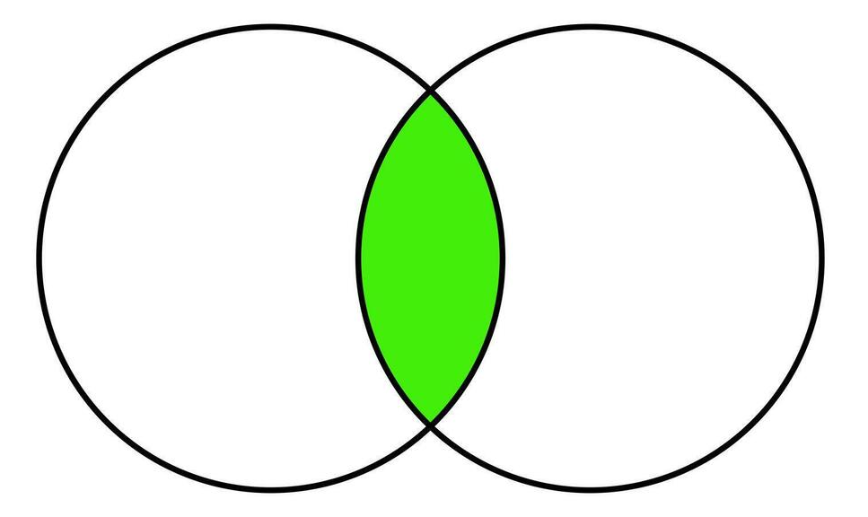
Sets
TMS1113 : Foundation of Mathematics

Slide 2
What are Sets?
A set is a collection of well-defined and distinct objects.
Examples:
  - A = {1, 2, 3, 4} (a set of integers)
  - B = {apple, orange, banana} (a set of fruits)
Representation:
- Roster form: Listing elements, e.g., A = {1, 2, 3}
- Set-builder form: Describing properties, e.g., A = {x | x > 0, x ∈ ℤ}

Slide 3
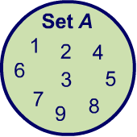
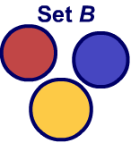
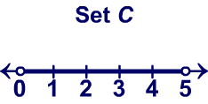
Sets and elements
A set consists of objects or elements. The elements can be numbers, letters, etc. Elements are listed inside curly brackets.
Sets can have a finite or infinite number of elements, or they can be empty. Empty sets, called the null set, have no elements and are denoted by the symbol ∅.
A = {1, 2, 3, 4, 5, 6, 7, 8, 9}
is a set of single digit positive numbers.
B = {red, yellow, blue}
is the set of primary colors
C = {x|0 < x < 5}
is the set of numbers between 0 and 5
Notes:
3
Teacher notes
Remind students that in set C, the horizontal bar can be read as “such that”. Ask students to think of other possible sets.
As a challenge, consider asking students to list other sets that contain the sets they have given, for example if someone has said “dogs”, “mammals” or “animals” are examples of sets that contain this. These are called supersets.

Slide 4
Sets:Representation
- Roster form: Listing elements, e.g., A = {1, 2, 3}
- Set-builder form: Describing properties, e.g., A = {x | x > 0, x ∈ ℤ}

Slide 5
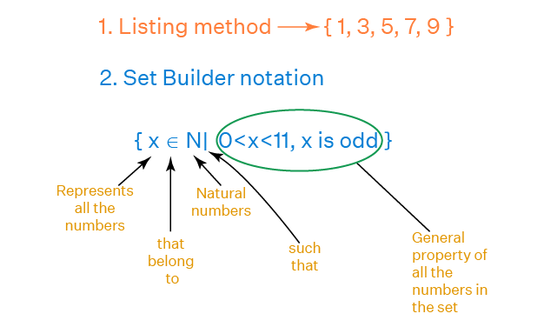
Sets:Representation

Slide 6
Set Builder Form
Example:
A = {x | x is an even number less than 10}
Result: A = {2, 4, 6, 8}
Exercise:
Write the set of all positive integers less than 7 in set-builder form.
Represent the set of vowels in set-builder form.

Slide 7
Exercises:
A={2,4,6,8,10}
Answer: A={x∈ ℕ ∣ 2≤x≤10, x is even}
A is the set of all x in the natural numbers such that x is greater than or equal to two and less than or equal to ten, and x is even
B={1,2,3,4}
Answer: B={x∈ ℕ ∣ 1≤x<5}
B is the set of all x in the natural numbers such that x is greater than or equal to one and less than five.

Slide 8
C={−3,−2,−1,0,1,2,3}
Answer: C={x∈ ℤ ∣ −3≤x≤3}
C is the set of all x in the integers such that x is greater than or equal to negative three and less than or equal to three
D={Sunday, Monday, Tuesday}
Answer: D={x ∣ x is a day of the week and comes before Wednesday}
E={1,4,9,16,25}
Answer: E={x ∣ x=n², n∈ℕ, 1≤n≤5}
E is the set of all x such that x equals n squared, where n is a natural number and n is between one and five inclusive

Slide 9
Equality of Two Sets
Two sets are equal if they have exactly the same elements.
Example:
A = {1, 2, 3}, B = {3, 2, 1} → A = B
Key Points:
Order of elements does not matter.
Repetition of elements does not affect equality.
Exercise:
Determine if the following sets are equal:
1. A = {a, b, c}, B = {b, c, a}
2. A = {1, 2, 3, 3}, B = {3, 2, 1}

Slide 10
A set only contains unique elements, meaning duplicate elements are ignored.
Set A={1,2,3,3} simplifies to {1,2,3}
Set B={3,2,1} also contains the same elements, though in a different order.
Since sets do not consider the order of elements and only focus on the content, A=B.

Slide 11
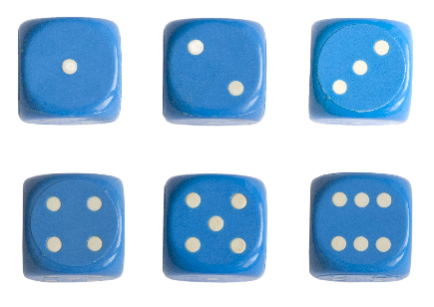
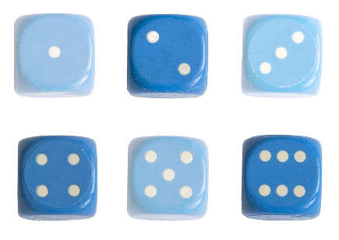
Subsets
What is the set of possible outcomes from rolling a die?
A = {1, 2, 3, 4, 5, 6}
What is the set of possible even outcomes?
A_{e} = {2, 4, 6}
The universal set is the largest possible set for a given scenario. For this example, A is the universal set.
A_{e} is a subset of all the possible outcomes, A, because is contains some of the elements of A. The null set is a subset of every set.
Subsets are denoted using the ⊆ symbol.
A_{e} ⊆ A
Notes:
11
Teacher notes
Ask students to list other subsets of the universal set A using the subset notation. Ask them to give examples of other universal sets and their possible subsets.
Photo credit: © vesna cvorovic 2012, Shutterstock.com

Slide 12
Let set A = {1, 2, 3} and set B = {1, 2, 3, 4}.
A is a subset of B because all elements of A (1, 2, and 3) are also in B.
A ⊆ B
Subset: A ⊆ B (A is a subset of B).

Slide 13
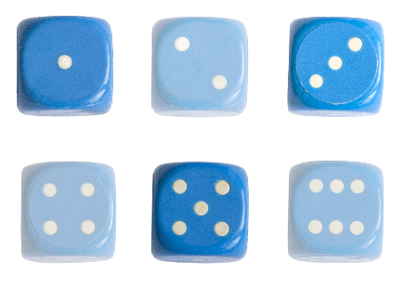
Complement
The complement of a set is all of the elements in the universal set but not in the set of interest.
Complements of sets are denoted using a prime symbol ′.
What is the complement of the set of even outcomes when rolling a die?
universal set:
A = {1, 2, 3, 4, 5, 6}
set of even outcomes:
A_{e} = {2, 4, 6}
complement of set:
A_{e}′ = {1, 3, 5}, the set of possible odd numbers.
Notes:
13
Mathematical practices
7) Look for and make use of structure.
They should be able to identify the opposite outcomes from the set of interest within the universal set.
Photo credit: © vesna cvorovic 2012, Shutterstock.com

Slide 14
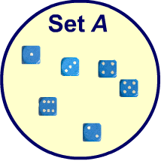
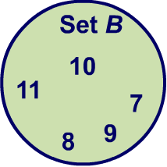

Unions
The union of two or more sets contains all the elements in all the sets.
The union of sets A and B is the elements in either set A or B or both.
Unions of sets are denoted by the symbol ∪.
What is the union of set A, the outcomes of rolling a dice, and set B, all positive integers between 7 and 11?
set A = {1, 2, 3, 4, 5, 6}
set B = {7, 8, 9, 10, 11}
A ∪ B = {1, 2, 3, 4, 5, 6, 7, 8, 9, 10, 11}
Notes:
14
Teacher notes
Ask students to list subsets of the union of A and B. They may list even or odd numbers or any other range of numbers between 1 and 11. Ask them to also give the complements to the subsets they come up with.
Mathematical practices
6) Attend to precision.
Students should compare two sets of numbers and identify all elements which are the same. They should make sure not to neglect any elements when describing A ∪ B.
Photo credit: © vesna cvorovic 2012, Shutterstock.com

Slide 15
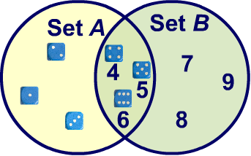
Intersections
The intersection of two or more sets contains all the elements that are in all sets.
For example, all the elements in set A and B.
Intersections of sets are denoted by the symbol ∩.
What is the intersection of set A, the outcomes of rolling a dice, and set B, all positive integers between and inclusive of 4 and 9?
set A = {1, 2, 3, 4, 5, 6}
set B = {4, 5, 6, 7, 8, 9}
A ∩ B = {4, 5, 6,}
Notes:
15
Teacher notes
Ask students to consider what the notation would be for the complement of A ∩ B.
Mathematical practices
6) Attend to precision.
Students should compare two sets of numbers and identify all elements which are the same. They should be careful in using the correct notation to describe the intersection.

Slide 16
Disjoint sets
Disjoint sets are two or more sets that have no elements in common, therefore the intersection is an empty set.
For example: a set of all 3D shapes with a curved surfaces, and B, a set of all polyhedrons, are disjoint sets.
Eg:
Set A = {1, 3, 5, 7}
Set B = {2, 4, 6, 8}
These sets are disjoint because they share no common elements. Their intersection (A ∩ B) is an empty set: { }.
A ∩ B = ∅
Notes:
Teacher notes
Students can use what they have learned about 3D shapes to realize that the intersection of A and B is empty.
Mathematical practices
1) Reason abstractly and quantitatively.
There are no elements that belong to both sets, so the intersection does not contain any elements. Students should realise that it is therefore the empty set.
7) Look for and make use of structure.
Students should use what they know about the structure of 3D shapes and the characteristics of polyhedrons in order to recognise that the intersection is empty.

Slide 17
1. Find the union of set X = {2, 3, 4} and Y = {4, 5, 6}
X ∪ Y
2. Find the intersection f set X = {2, 3, 4} and Y = {4, 5, 6}
X ∩ Y =
3. Find whether X is subset of Y or not where set X = {2, 3, 4} and
Y = {2, 3, 4, 5, 6}.
X ⊆ Y or X ⊄ Y

Slide 18
A and B are disjoint or not ?
Check if the following sets are disjoint:
1. A = {1, 2, 3}, B = {4, 5, 6}
2. A = {x | x > 9}, B = {x | x ≤ 10}
3. A ={x ∣ x=n², n∈ℕ, 1 ≤ n ≤ 5}, B= ={x ∣ 1 ≤ x ≤ 5, x is even}
4. A ={x ∣ x=n³, n∈ℕ, 1 ≤ n ≤ 5}, B= ={x ∣ 1 ≤ x ≤ 10, x is prime}

Slide 19
A = {x | x > 9}, B = {x | x ≤ 10}
Set A contains all numbers greater than 9 (i.e., {10, 11, 12, ...}).
Set B contains all numbers less than or equal to 10 (i.e., {..., 8, 9, 10}).
Common element: 10 is in both sets.
❌ A and B are not disjoint. (They share the element 10.)
A = {1, 3, 5}, B = {2, 4, 6}
Set A contains {1, 3, 5}.
Set B contains {2, 4, 6}.
There is no common element between these sets.
✅ A and B are disjoint.

Slide 20
Finite and Infinite Sets
Finite Set: A set with a countable number of elements.
Example: A = {1, 2, 3, 4}
Infinite Set: A set with an uncountable number of elements.
Example: B = {x | x > 0}
Exercise:
- Identify whether the following sets are finite or infinite:
1. A = {2, 4, 6, ..., 20}
2. B = {x | x is a natural number}

Slide 21
Set Operations
Difference: A - B = {x | x ∈ A and x ∉ B}
Example: A = {1, 2, 3}, B = {2, 3} → A - B = {1}
Complement: A' = Universal Set - A
Example: U = {1, 2, 3, 4}, A = {2, 4} → A' = {1, 3}

Slide 22
Example:
If A = {a, b, c, d, e} and B = {c, d, f, g},
then A - B = {a, b, e} and
B - A = {f, g}.
Example:
If A = {1, 2, 5} and B = {2, 5},
then A - B = {1} and
B - A = {} (the empty set).
Exercise:
- Find the difference and complement:
1. A = {x | x < 5}, B = {x | x is even}.

Slide 23
A = {x | x < 5}
This includes all numbers less than 5, i.e., {..., -3, -2, -1, 0, 1, 2, 3, 4}.
B = {x | x is even}
This includes all even numbers, i.e., {..., -4, -2, 0, 2, 4, 6, 8, ...}.
(A ∩ B) = ?
(A ∩ B) = {-2, 0, 2, 4}
A – B = ?
A - B = Elements in A that are not in B → {…-5, -3, -1, 1, 3}.
B-A = Elements in B that are NOT in A → {..., 6, 8, 10, ...} (All even numbers ≥ 5).
So, B - A = {x | x is even and x ≥ 5}.

Slide 24
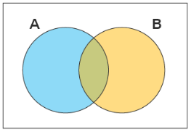
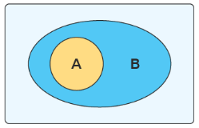
Venn Diagrams
A Venn diagram is a diagram that helps us visualize the logical relationship between sets and their elements
A Venn diagram typically uses intersecting and non-intersecting circles to denote the relationship between sets

Slide 25
Highlight the areas,
1. P only
Q
2. Q only
P
3. P & Q

Slide 26
Create a Venn diagram for:
Multiples of 5 from 1 to 25
Even numbers from 1 to 25

Slide 27
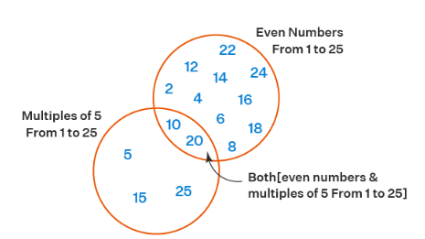

Slide 28
ε
P
1. P only
Q
2. Q only
3. R only
4. P & Q only
5. P & R only
6. Q & R only
7. P, Q & R
R

Slide 29
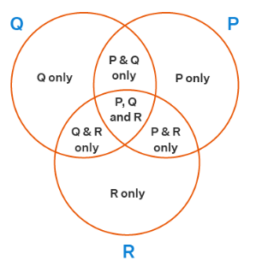

Slide 30
Venn Diagrams
Example:
A ∪ B: Shaded area includes both A and B.
A ∩ B: Shaded area includes only common elements of A and B.
Exercise:
- Draw Venn diagrams for:
1. A ∩ B
2. A ∪ B

Slide 31
1. Set A
2. Complement of Set A (A’)

Slide 32
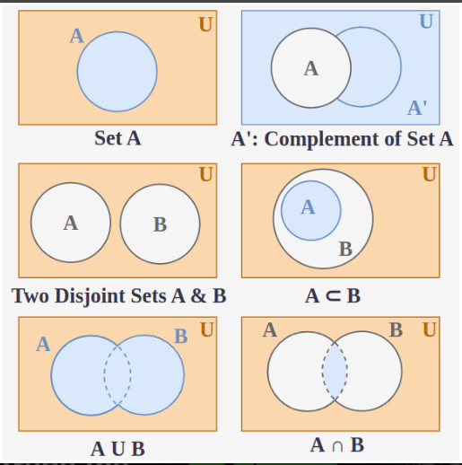
1. Set A
2. Complement of Set A (A’)

Slide 33
1. Two disjoint sets A & B
2. A ⊂ B

Slide 34
1. Two disjoint sets A & B
2. A ⊂ B

Slide 35
1. A ∪ B
2. A ∩ B

Slide 36
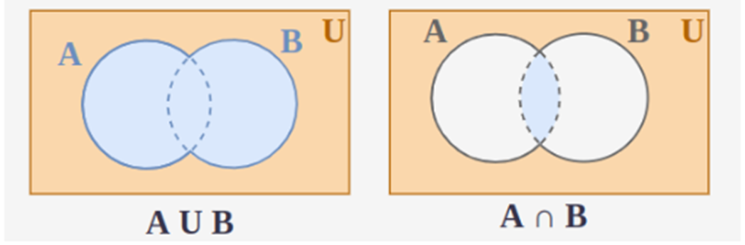
1. A ∪ B
2. A ∩ B

Slide 37
Exercises
1: Find the intersection for set P = {1, 3, 5} and Q = {2, 5, 8}.
2: Find the union of set P = {5, 10} and Q = {12, 15, 18}.
3: Find the difference of set P = {1, 3, 5} and Q = {2, 5, 8}.

Slide 38
Exercises
1: Find the intersection for set P = {1, 3, 5} and Q = {2, 5, 8}.
P ∩ Q = {5}
2: Find the union of set P = {5, 10} and Q = {12, 15, 18}.
P ∪ Q = {5, 10, 12, 15, 18}
3: Find the difference of set P = {1, 3, 5} and Q = {2, 5, 8}.
P - Q = {1, 3}

Slide 39
Exercises
4: Find the complement of set X = {a, b, d} and U = {a, b, c, d, e}.
5: Find whether P is subset of Q or not where set P = {2, 4} and

Slide 40
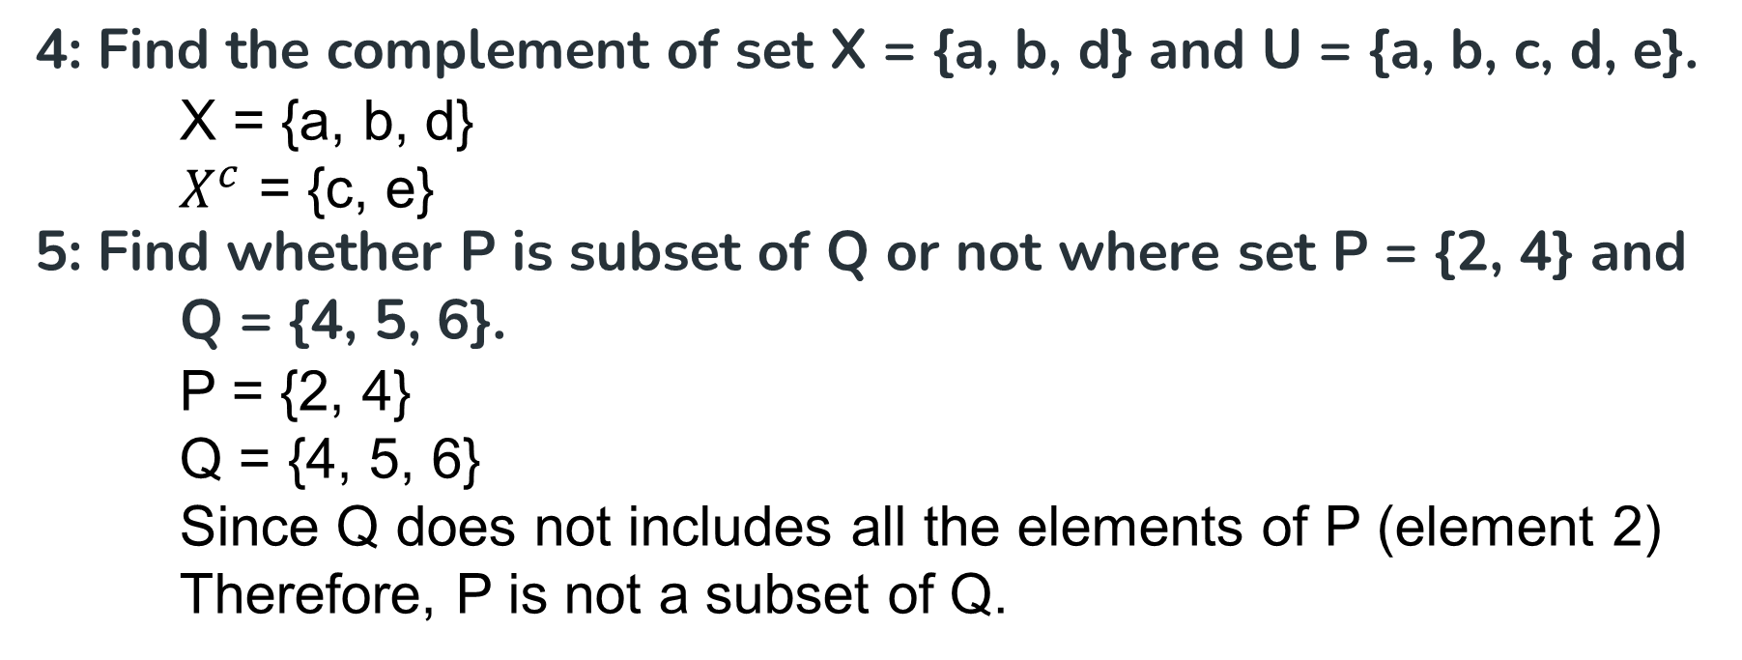
Exercises
4: Find the complement of set X = {a, b, d} and U = {a, b, c, d, e}.
X = {a, b, d}
$X^{c}$ = {c, e}
5: Find whether P is subset of Q or not where set P = {2, 4} and Q = {4, 5, 6}.
P = {2, 4}
Q = {4, 5, 6}
Since Q does not includes all the elements of P (element 2)
Therefore, P is not a subset of Q.

Slide 41
Unions and intersections
Let A be the set of all letters in the alphabet.
A = {A, B, C, …}
Let B be the set of all vowels in the alphabet.
B = { A, E, I, O, U}
Let C be the set of all letters in your name.
Draw a Venn diagram to represent these sets.
What is the universal set and which are subsets?
A is the universal set in this scenario.
B is a subset of A.
C is a subset of A.
Describe B′.
List the elements in B ∩ C and B ∪ C?
Notes:
41
Teacher notes
Ask students make a Venn diagram to represent these sets. Ask them to write out the elements of set C.
When considering B’ students should do more than just say that it is all letters that are not vowels. They know that if a letter is not a vowel then it is a consonant. They should describe B’ as the set of consonants.
The final question will depend on the students name. Ask students to work in pairs to check each other’s answers to this question.

Slide 42
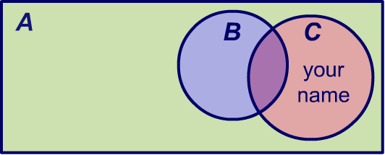
Unions and intersections
Let A be the set of all letters in the alphabet.
A = {A, B, C, …}
Let B be the set of all vowels in the alphabet.
B = { A, E, I, O, U}
Let C be the set of all letters in your name.
Draw a Venn diagram to represent these sets. What is the universal set and which are subsets?
A is the universal set in this scenario.
B is a subset of A.
C is a subset of A.
Describe B′.
B′ is the set of all consonants in the English alphabet.
List the elements in B ∩ C and B ∪ C?
Notes:
42
Teacher notes
Ask students make a Venn diagram to represent these sets. Ask them to write out the elements of set C.
When considering B’ students should do more than just say that it is all letters that are not vowels. They know that if a letter is not a vowel then it is a consonant. They should describe B’ as the set of consonants.
The final question will depend on the students name. Ask students to work in pairs to check each other’s answers to this question.

Slide 43
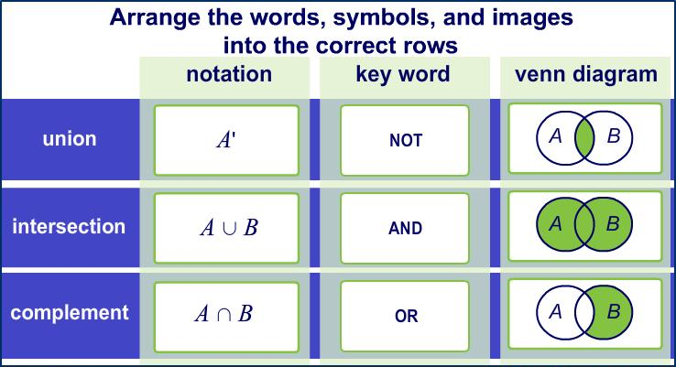
Language of sets
Notes:
43

Slide 44
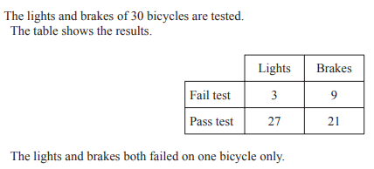
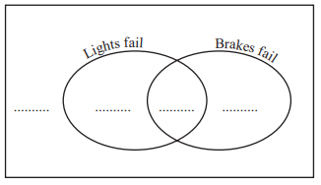

Slide 45
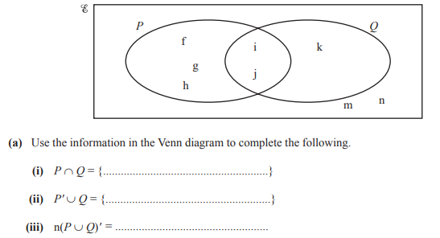

Slide 46
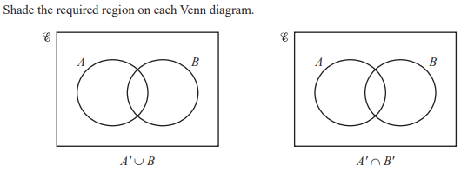

Slide 47
Cartesian Product
Definition: Given two sets, A and B, the Cartesian product of A and B, denoted by A × B, is the following set:
{(a,b) | a ∈A and b ∈ B}
pair or 2-tuple
Examples:
  What is: {1, 2 , 3} × {a,b} =
  True or false: {(1,a), (3,b)} ⊆ {1, 2 , 3} × {a,b}
  True or false: {1,2,3} ⊆ {1, 2 , 3} × {a,b}
{(1,a), (1,b), (2,a), (2,b), (3,a), (3,b)}
true
false

Slide 48
Cartesian Product II
Definition: Given three sets, A, B and C, the Cartesian product of A, B, and C denoted by A × B × C, is the following set:
{(a,b,c) | a ∈A, b ∈ B, c ∈ C}
Triple or 3-tuple
Definition. (x,y,z) = (x’,y’, z’) only if
x = x’, y = y’ and z = z’
These definitions can be extended to define the Cartesian product:
A₁ × A₂ × … × A_{n}
and equality between n-tuples

Slide 49

Properties of the zero($0$) and infinity($∞$)
In mathematics, zero and infinity have unique properties that play an important role in algebra and calculus.
Let’s learn the basic properties of zero and infinity, two essential concepts in mathematics.

Slide 50
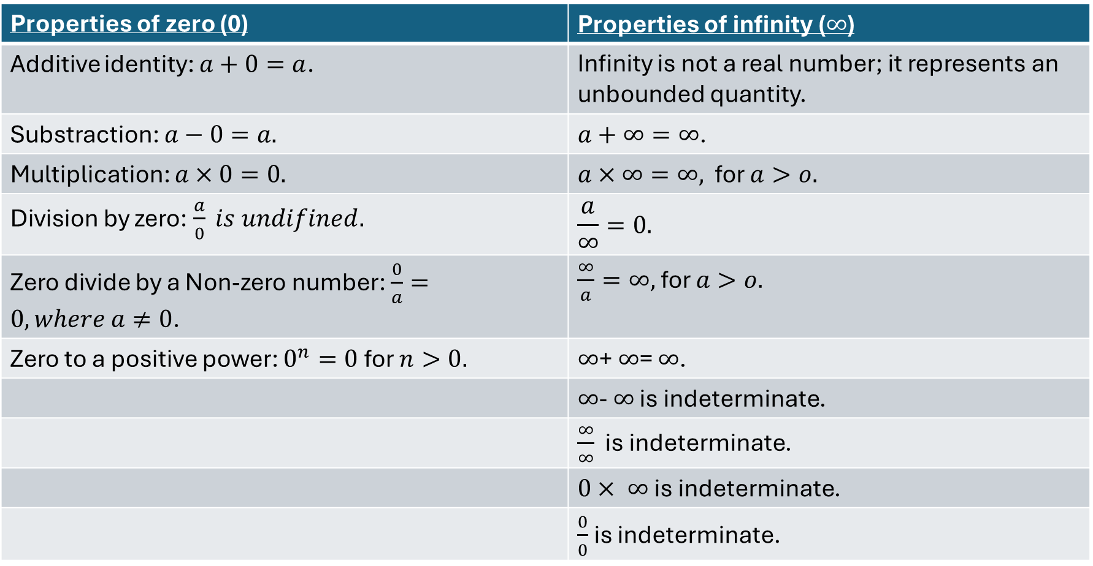

Properties of the zero($0$) and infinity($∞$)
Properties of zero (0) | Properties of infinity ($∞$)
Additive identity: $a+0=a$. | Infinity is not a real number; it represents an unbounded quantity.
Substraction: $a−0=a.$ | $a+∞=∞$.
Multiplication: $a×0=0.$ | $a×∞=∞,$ for $a>o.$
Division by zero: $\frac{a}{0} is undifined.$ | $$\frac{a}{∞}=0.$$
Zero divide by a Non-zero number: $\frac{0}{a}=0, where a≠0$. | $\frac{∞}{a}=∞,$ for $a>o.$
Zero to a positive power: $0^{n}=0$for $n>0.$ | $∞$+ $∞$= $∞$.
 | $∞$- $∞$ is indeterminate.
 | $\frac{∞}{∞}$ is indeterminate.
 | $0× ∞$is indeterminate.
 | $\frac{0}{0}$ is indeterminate.

Slide 51
Thank You

